Slide 1
Capstone project
The battle of Neighborhoods

Slide 2
Introduction
The main purpose of this project is to help people identify better neighbourhoods out of all neighbourhoods listed in Toronto, Canada
This Project aim to create an analysis of features for a people migrating to Scarborough to search a best neighbourhood as a comparative analysis between neighbourhoods. The features include median housing price and better school according to ratings, crime rates of that particular area, road connectivity, weather conditions, good management for emergency, water resources both fresh and waste water and excrement conveyed in sewers and recreational facilities.
It will help people to get awareness of the area and neighbourhood before moving to a new city, state, country or place for their work or to start a new fresh life.

Slide 3
Problems solved
a) Sorted list of house in terms of housing prices in a ascending or descending order b) Sorted list of schools in terms of location, fees, rating and reviews
The Location: Scarborough is a popular destination for new immigrants in Canada to reside. As a result, it is one of the most diverse and multicultural areas in the Greater Toronto Area, being home to various religious groups and places of worship.

Slide 4
Data Section:
FourSquare API: This project would use Four-square API as its prime data gathering source as it has a database of millions of places, especially their places API which provides the ability to perform location search, location sharing and details about a business.
Workflow: Using credentials of Foursquare API features of near-by places of the neighbourhoods would be mined. Due to http request limitations the number of places per neighbourhood parameter would reasonably be set to 100 and the radius parameter would be set to 500.
Clustering Approach: o compare the similarities of two cities, we decided to explore neighbourhoods, segment them, and group them into clusters to find similar neighbourhoods in a big city like New York and Toronto. To be able to do that, we need to cluster data which is a form of unsupervised machine learning: k-means clustering algorithm

Slide 5
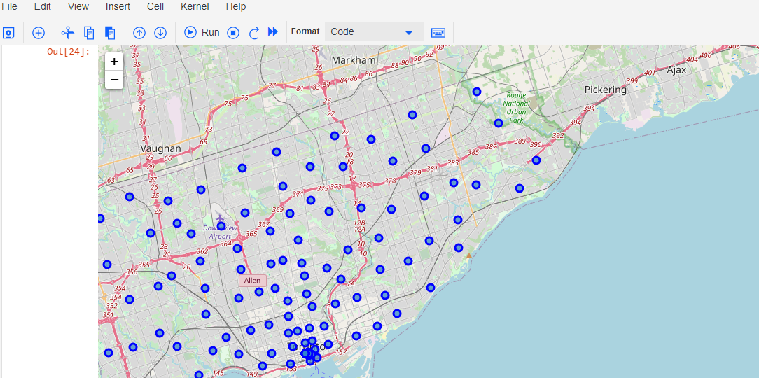
Map

Slide 6
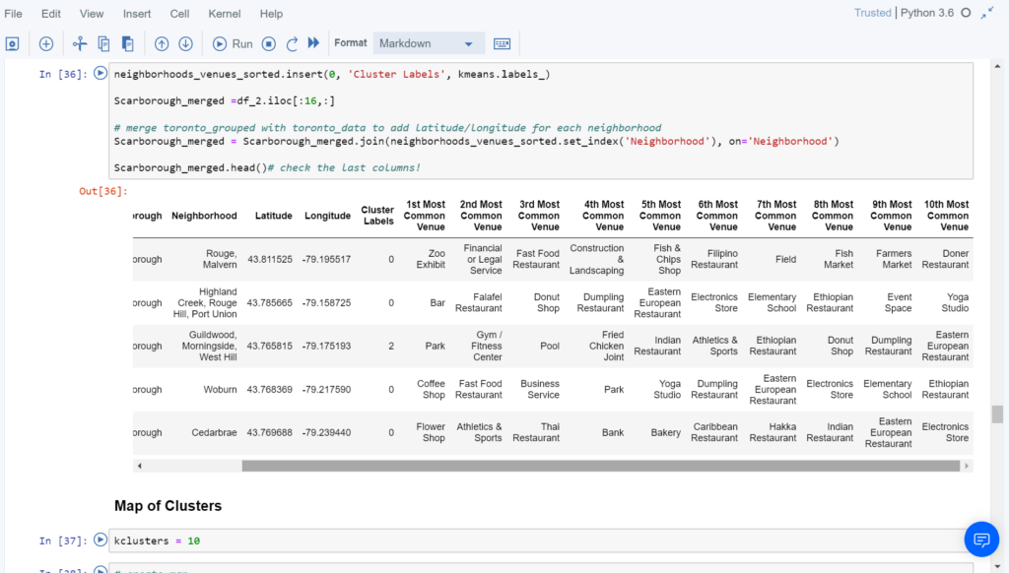
Methodology
K means clustering

Slide 7
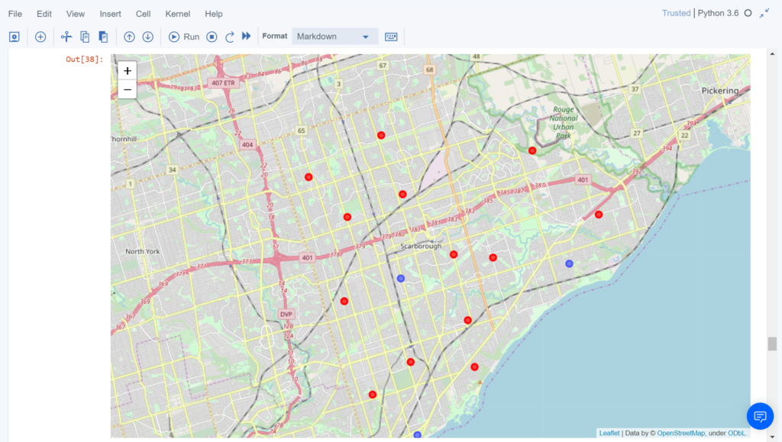
Results

Slide 8
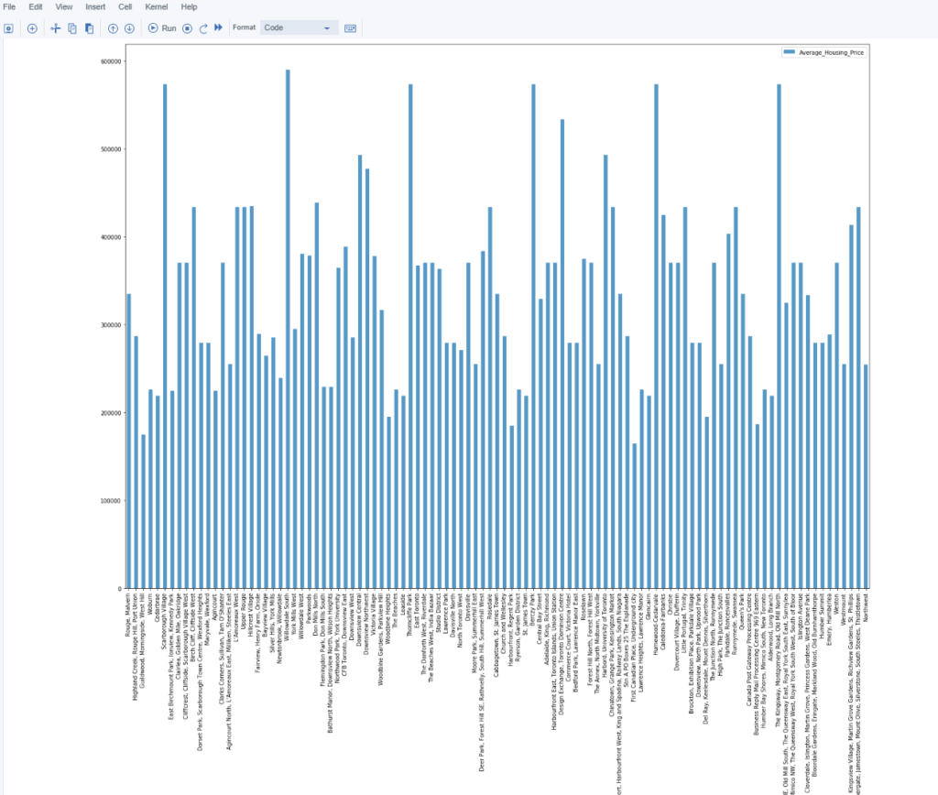
Housing prices in terms of clusters

Slide 9
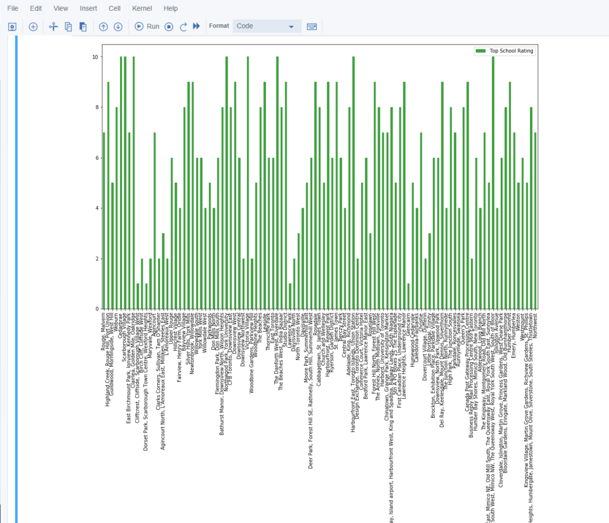
School ratings in terms of clusters

Slide 10
Conclusion
In this Capstone project, using k-means cluster algorithm I separated the neighborhood into 10(Ten) different clusters and for 103 different latitude and longitude from dataset, which have very-similar neighborhoods around them. Using the charts above results presented to a particular neighborhood based on average house prices and school rating have been made.

Slide 11
Future works
This Capstone project can be continued for making it more precise in terms to find best house in Scarborough. Best means on the basis of all required things (daily needs or things we need to live a better life) around and also in terms of cost effective.

Slide 12
Libraries used:
Pandas: For creating and manipulating dataframes.
Folium: Python visualization library would be used to visualize the neighborhoods cluster distribution of using interactive leaflet map.
Scikit Learn: For importing k-means clustering.
JSON: Library to handle JSON files.
XML: To separate data from presentation and XML stores data in plain text format.
Geocoder: To retrieve Location Data.
Beautiful Soup and Requests: To scrap and library to handle http requests.
Matplotlib: Python Plotting Module.

Slide 13
Thank you!

